Slide 1


3D Graphics
Workshop 11 – Coursera week 11 and 12

Slide 2
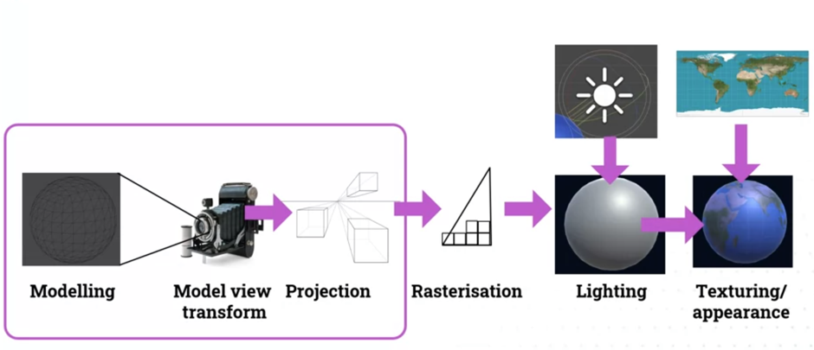
Rendering and the Graphics Pipeline

Slide 3
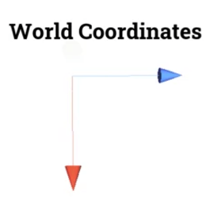
Modelling World Coordinate System
The 3D Unity world
has world coordinates.
gives us the default 00 position and the x, y, and z axis
think of this as the underlying grid.

Slide 4

Modelling Object Coordinate System
Each object has its own
coordinate systems.
transform (local x direction, y direction, z direction, scale,)
very different from the world coordinates.
Each object can be
rotated,
at different position
different scale
All the polygons and the vertices of the object are expressed in objects coordinate systems.

Slide 5
Modelling Object Coordinate System
Each object,
even though they can be the same, the 3D model can have a different coordinate system
because it has a different transform.
The coordinate systems are determined by the transform.
A model space,
the space in which the vertices of the objects are expressed in.
For example, the object is modelled in another software
the x, y, and z, and the 0, 0, 0 position of the model of each object.
need to be converted into world space which is different for each object using Transformation matrix .

Slide 6
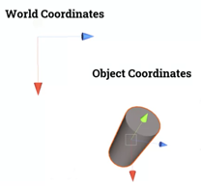
Modelling Object Coordinate System
Transform matrix of that object
transforms from the local model space of the polygons into the world space of unity with that matrix transform.
A single object might
have multiple matrix transforms because there might be a hierarchy.
hierarchy: one object with the transform underneath another game object that also has a transform.
Generally, combine all these transforms together into a single matrix by multiplying them together.
convenient.
much quicker
All those transforms give us world space coordinate systems,
Next, need to convert from world space coordinate systems into the camera space coordinate systems.

Slide 7
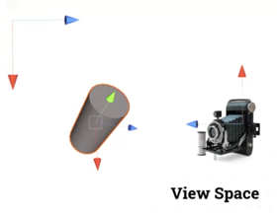
Model view transform Camera Coordinate System
Aka View space
All this means is
where an object is relative to the camera,
how far away it is from the camera,
what directions is relative to the camera.
Conversion from world space coordinates to camera space coordinates
Use inverse transform matrix of the camera.
Next need to project these into 2D, and that gives us the 2D objects.
After projection, convert 2D objects to fragments (something like a pixel) via the rasterization process.
Fragments are smallest points on image data
Pixels are smallest points on the display.

Slide 8
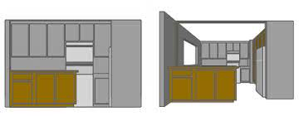
Projection
Two ways:
Parallel/Orthographic projection.
orthographic (used in computer graphics)
Parallel/Orthographic projection
get rid of the z’s, x and y distances stay the same
preserving distances so that can make measurements of it,
for technical drawing (architect or an engineer)
Perspective projection
the further away an object is, the smaller it looks on the screen, just as it does in real life.
creates very realistic views of an object.

Slide 9
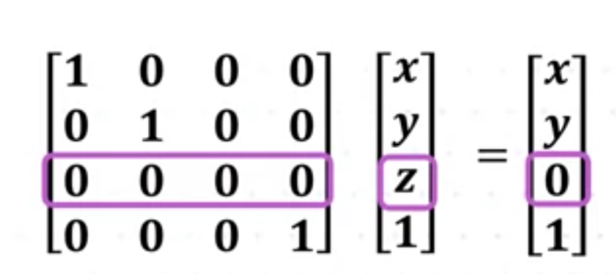
Parallel/Orthographic Projection

Slide 10
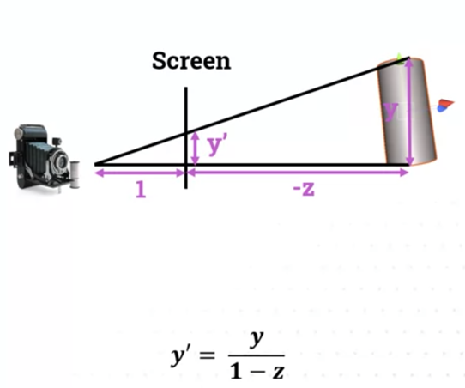
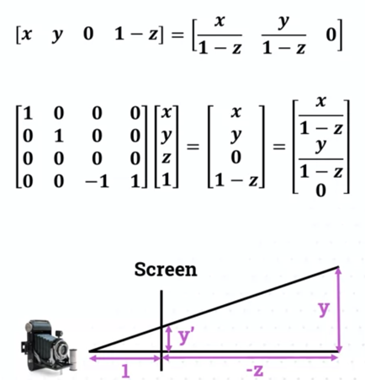
Perspective Projection
Done using similar triangle concept.

Slide 11
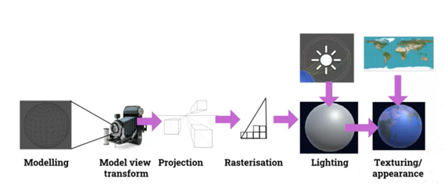
Rasterization
After projection, convert 2D objects to fragments (something like a pixel) via the rasterization process.
Rasterization process
converting objects described with vector graphics into a raster image
raster image
a series of pixels, something we then use to display our 2D screen.

Slide 12
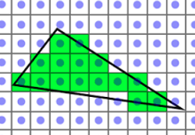
Rasterization
Triangle (and other types of primitives) are continuous geometric objects,
but screens are actually discrete with a finite number of pixels.
Rasterization computes a discrete approximation of the geometric shapes for display.

Slide 13
Rasterization
Desired Rasterization algorithm properties
Uniform thickness
Continuous appearance (no holes)
Efficiency
Simplicity (for hardware implementation)

Slide 14
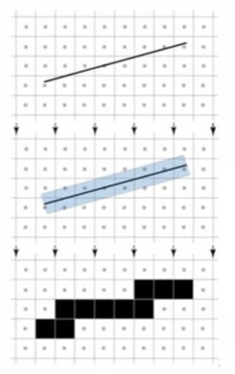
Line Rasterization
Point-sampled line rasterization
Assume the line is actually a rectangle.
For each pixel on the display, test if it is inside this rectangle.
If it is, then we turn it black,
otherwise, we leave it white
not efficient
Need to test all pixels on the display
No constant thickness

Slide 15
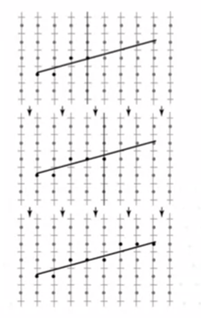
Line Rasterization
Midpoint line rasterization
For each column, turn on the the closest pixel
Goes from the start x value to the end.
For each of the x value, calculate the y and choose one pixel to turn on.
Simple algorithm
Need to calculate y for each x
Evaluating y and choosing the closest pixel is slow!

Slide 16
Line Rasterization
Bresenham’s line rasterization.
For each step, two options
Same y or
Move up by 1.
Assumption:
gradient m is between 0 to 1
x = round(x₀)
y = round(m*x + b)
d = m*(x+1)+b-y
while(x<round(x₁)){
output(x,y,1)
x += 1
d+= m
if(d>0,5){
y += 1
d -= 1
}
}

Slide 17
Line Rasterization
Bresenham’s line rasterization.
If m between 0 and -1
Replace
d+=m with d-=m
y+=1 with y-=1
x = round(x₀)
y = round(m*x + b)
d = m*(x+1)+b-y
while(x<round(x₁)){
output(x,y,1)
x += 1
d-= m
if(d>0,5){
y -= 1
d -= 1
}
}

Slide 18
Line Rasterization
Bresenham’s line rasterization.
If m more than 1
Swap x and y
Swap value of x and y
Recompute m
x = round(x₀)
y = round(m*x + b)
d = m*(x+1)+b-y
while(x<round(x₁)){
output(y,x,1)
x += 1
d+= m
if(d>0,5){
y += 1
d -= 1
}
}

Slide 19
Line Rasterization
Bresenham’s line rasterization.
If m less than -1
Swap x and y
Replace
x+=1 with x-=1
d+=m with d-=m
Swap value of x and y
Recompute m
x = round(x₀)
y = round(m*x + b)
d = m*(x+1)+b-y
while(x>round(x₁)){
output(y,x,1)
x -= 1
d-= m
if(d>0,5){
y += 1
d -= 1
}
}

Slide 20
Lab
Work on Workshop 10 Lab 2.
In this lab we will implement the 4 cases of Bresenham’s line rasterization in P5.js

Slide 21
Hidden surface removal
Drawing polygonal faces on screen consumes CPU cycles ¡ We cannot see every surface in scene
Don’t want to waste time rendering primitives which don’t contribute to the final image
Situation to remove hidden surface
Back faces
Polygons at the back of the object that cannot be seen
Occlusion
One object blocking another object
Outside viewport
Object that is partial or completely outside of the viewport.

Slide 22
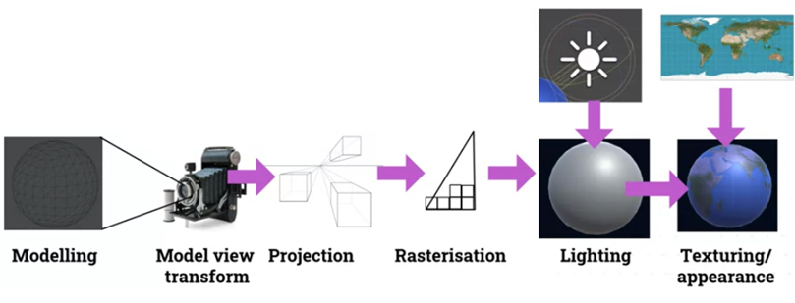
Hidden surface removal
In graphics pipeline
After projection
Remove Polygons that are back-facing or off screen.
Clip polygons that are partial off screen
Remove/clip
Polygons

Slide 23
Hidden surface removal
In graphics pipeline
Hide fragments that are occluded at the end
Hide fragments

Slide 24
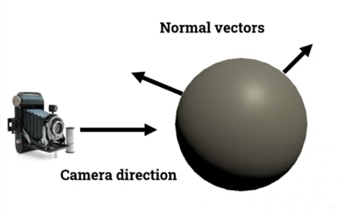
Back face culling
Remove polygons that have normal vector pointing away from the camera.
Preform dot product of the
camera direction vector and the normal vector
if the dot product
is negative, pointing towards the camera
is positive, they're pointing away.

Slide 25
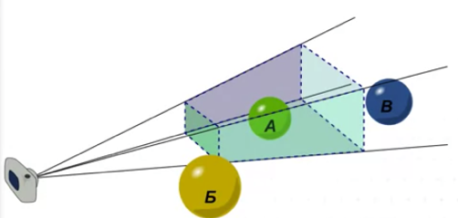
View frustrum clipping
Remove or clip polygons that are outside of viewpoints
If polygon completely inside frustrum, draw it.
If polygon completely outside frustrum, don’t draw it.
If polygon completely partially inside and outside frustrum, clip it.
Create a new clipped polygon.

Slide 26
View frustrum clipping
Object that are
too near (Infront of the front wall)
too far (behind the back wall)
will be removed as well

Slide 27
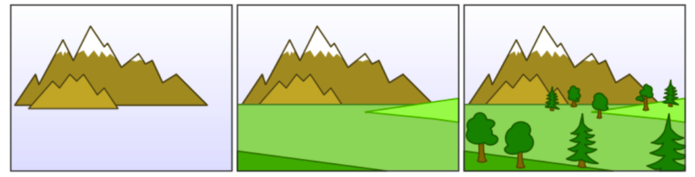
Occlusion – Painter’s algorithm
Draw surfaces in back to front order – nearer polygons “paint” over farther ones.
Need to decide the order to draw – far objects first

Slide 28
Occlusion – Painter’s algorithm
Draw surfaces in back to front order – nearer polygons “paint” over farther ones.
Support occlusion naturally.
Supports transparency easily.
Key issue is order determination.
Need to sort the polygons according to depth.
Very easy to implement for simple cases
Not very efficient
need to sort all polygons
all polygons are rendered, even when they become invisible.

Slide 29
Occlusion – Z-buffer Algorithm
Basic idea
Test the z-depth of each pixel on the polygon to determine the closest (visible) surface.
The z-buffer stores values corresponding to the depth of each pixel.
If the new pixel is closer than one in the buffers, it will replace the buffered values:

Slide 30
Occlusion – Z-buffer Algorithm
Algorithm
Declare an array z_buffer(x, y) with one entry for each pixel position.
Initialise the array to the maximum depth.
for each polygon P
for each pixel (x, y) in P
compute z_depth at x, y
if z_depth < z_buffer (x, y) then
set_pixel (x, y, colour)
z_buffer (x, y) <= z_depth

Slide 31
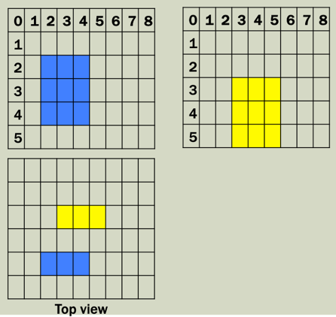
Occlusion – Z-buffer Algorithm
Algorithm
Consider the two polygons.
The blue square is in- front of the yellow square.
All pixels in blue square has a z coordinate value of 1.
All pixels in yellow square has a z coordinate value of 3.
Max depth is 5.

Slide 32
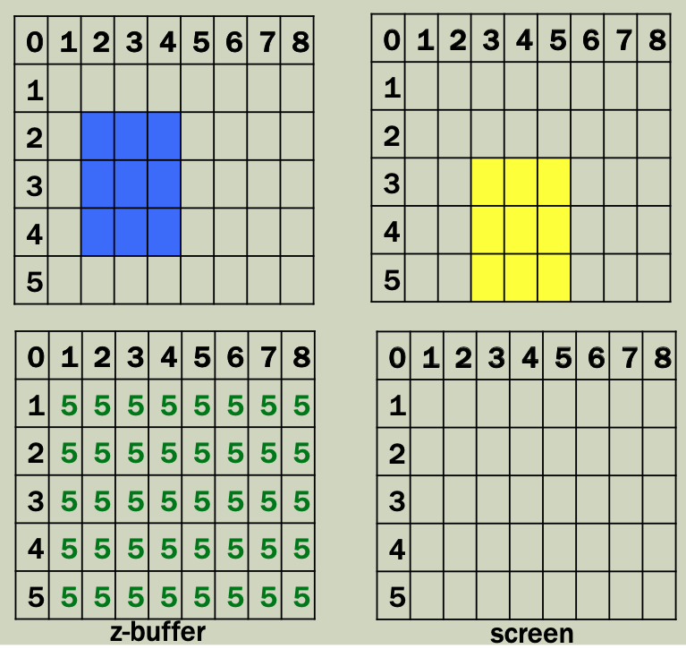
Occlusion – Z-buffer Algorithm
Algorithm
Declare an array z_buffer(x, y) with one entry for each pixel position.
Initialise the array to the maximum depth.

Slide 33
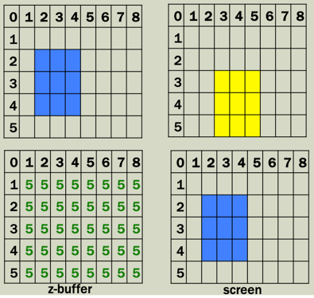
Occlusion – Z-buffer Algorithm
Algorithm
for each polygon P
(blue square)
for each polygon P
for each pixel (x, y) in P
compute z_depth at x, y
if z_depth < z_buffer (x, y) then
set_pixel (x, y, colour)
z_buffer (x, y) <= z_depth

Slide 34
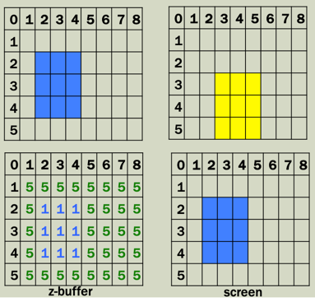
Occlusion – Z-buffer Algorithm
Algorithm
for each polygon P
(blue square)
for each polygon P
for each pixel (x, y) in P
compute z_depth at x, y
if z_depth < z_buffer (x, y) then
set_pixel (x, y, colour)
z_buffer (x, y) <= z_depth

Slide 35
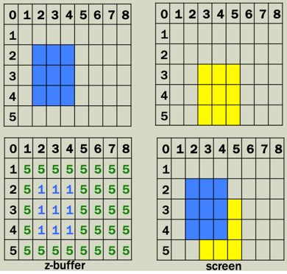
Occlusion – Z-buffer Algorithm
Algorithm
for each polygon P
(yellow square)
for each polygon P
for each pixel (x, y) in P
compute z_depth at x, y
if z_depth < z_buffer (x, y) then
set_pixel (x, y, colour)
z_buffer (x, y) <= z_depth

Slide 36
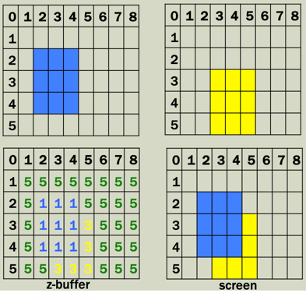
Occlusion – Z-buffer Algorithm
Algorithm
for each polygon P
(yellow square)
for each polygon P
for each pixel (x, y) in P
compute z_depth at x, y
if z_depth < z_buffer (x, y) then
set_pixel (x, y, colour)
z_buffer (x, y) <= z_depth

Slide 37
Occlusion – Z-buffer
Advantage
Efficient
don’t need to sort polygons
draw in any order
Handles occlusion fragment by fragment
Able to handle fine grain occlusion
Disadvantage
Does not work for transparent object
Need to sort and draw the transparent object on top of the other object behind.
Slower

Slide 38
Hidden surface removal
Backface
culling
Clipping
Z-Buffer

